Slide 1

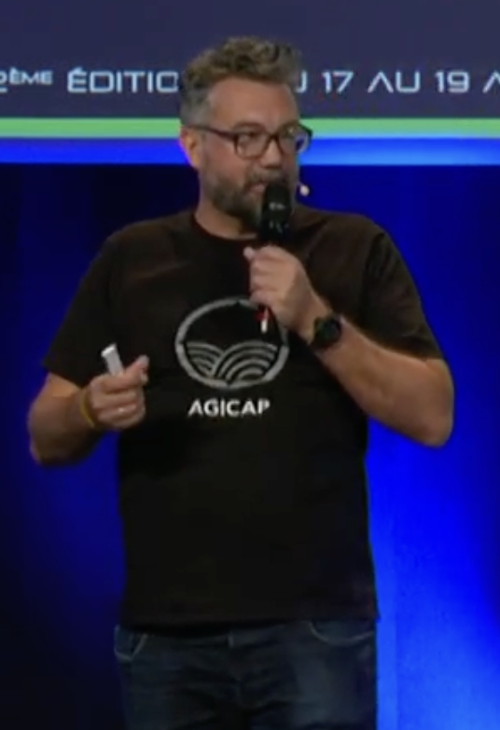
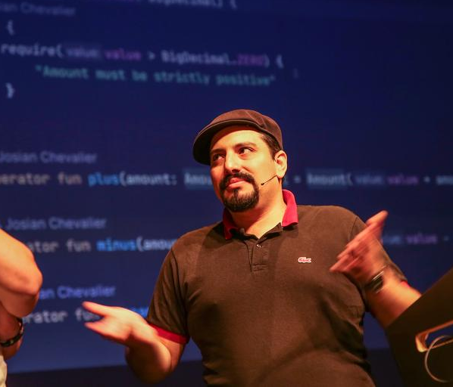

the hive
a scaling and supple architecture style for your growing and complex domain
#DDDFR
Julien Topçu Shodo
Thomas PIERRAIN Agicap
monday October 21th 2024 19h
Now Coworking
35 rue de Marseille 69007 LYON

